Slide 1
Regression Models

Slide 2
Ridge Regression vs. Least Squares
Least squares regression isn’t defined at all when the number of predictors exceeds the number of observations; It doesn’t differentiate “important” from “less-important” predictors in a model, so it includes all of them. This leads to over-fitting a model and failure to find unique solutions.
Least squares also has issues dealing with multi-collinearity in data. Ridge regression avoids all of these problems. It works in part because it doesn’t require unbiased estimators; While least squares produces unbiased estimates, variances can be so large that they may be wholly inaccurate. Ridge regression adds just enough bias to make the estimates reasonably reliable approximations to true population values.

Slide 3
LASSO
Lasso regression is a type of linear regression that uses shrinkage. Shrinkage is where data values are shrunk towards a central point, like the mean.
The lasso procedure encourages simple, sparse models (i.e. models with fewer parameters). This particular type of regression is well-suited for models showing high levels of muti-collinearity or when you want to automate certain parts of model selection, like variable selection/parameter elimination.
The acronym “LASSO” stands for Least Absolute Shrinkage and Selection Operator.

Slide 4
Logistic regression
Logistic Regression is used when the dependent variable(target) is categorical.
Types of Logistic Regression-
Binary Logistic Regression-
The categorical response has only two 2 possible outcomes. Example: Spam or Not
2. Multinomial Logistic Regression-
Three or more categories without ordering. Example: Predicting which food is preferred more (Veg, Non-Veg, Vegan)
3. Ordinal Logistic Regression-
Three or more categories with ordering. Example: Movie rating from 1 to 5

Slide 5
K-NEIBOURS CLASSIFIER /Regressor
How do we choose neighbors?
Algorithms
1.Brute Force-
Lets consider for simple case with two dimension plot. If we look mathematically, the simple intuition is to calculate the euclidean distance from point of interest ( of whose class we need to determine) to all the points in training set. Then we take class with majority points. This is called brute force method.
For N samples in D dimensions the running time complexity turns out to be O[DN²]. If we have small number of dimensions and training set, this would run in reasonable time. But as the training set size increases, the running time grows quickly.
Brute force performs worst when there are large dimensions and large training set.

Slide 6
Continued…….
K-D Tree-
To improve the running time, alternate approaches were invented on the line of building a growing tree from point of interest. These methods attempt to reduce the required number of distance calculations by efficiently encoding aggregate distance information for the sample.
Ball Tree
Ball tree assumes the data in multidimensional dimensional space and creates the nested hyper spheres. Query Time complexity is O[Dlog(N)].

Slide 7
Continued……
Which one to choose when?
The selection of the relevant algorithm for problem at hand depends on the number of dimensions and the size of training set.
For small sample size and small dimensions, brute force performs well.
Sparsity of data : If data is sparse with small dimensions (< 20) KD tree will perform better than Ball Tree algorithm.
Value of K (neighbors) : As the K increases, query time of both KD tree and Ball tree increases.

Slide 8
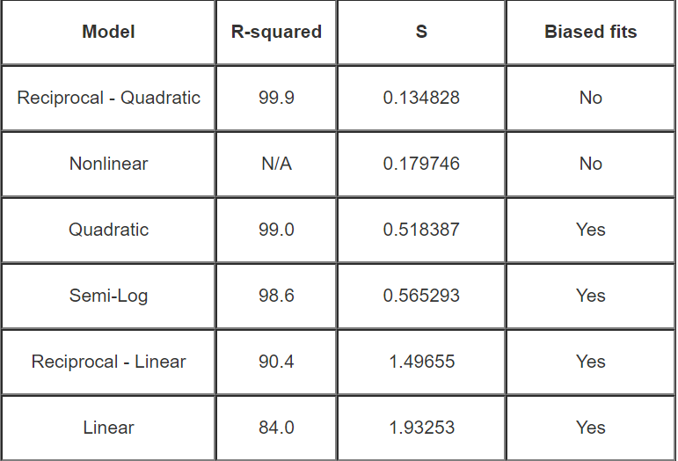
Model selection

Slide 9
Statistical Methods for Finding the Best Regression Model
Adjusted R-squared and Predicted R-squared: Generally, you choose the models that have higher adjusted and predicted R-squared values. These statistics are designed to avoid a key problem with regular R-squared—it increases every time you add a predictor and can trick you into specifying an overly complex model.
The adjusted R squared increases only if the new term improves the model more than would be expected by chance and it can also decrease with poor quality predictors.
The predicted R-squared is a form of cross-validation and it can also decrease. Cross-validation determines how well your model generalizes to other data sets by partitioning your data.

Slide 10
Continued……
P-values for the predictors: In regression, low p-values indicate terms that are statistically significant. “Reducing the model” refers to the practice of including all candidate predictors in the model, and then systematically removing the term with the highest p-value one-by-one until you are left with only significant predictors.
Stepwise regression and Best subsets regression: These are two automated procedures that can identify useful predictors during the exploratory stages of model building. With best subsets regression,

Slide 11
Ransac model
RANSAC (RANdom SAmple Consensus) fits a model from random subsets of inliers from the complete data set.
RANSAC is a non-deterministic algorithm producing only a reasonable result with a certain probability, which is dependent on the number of iterations (see max_trials parameter). It is typically used for linear and non-linear regression problems and is especially popular in the fields of photogrammetric computer vision.
The algorithm splits the complete input sample data into a set of inliers, which may be subject to noise, and outliers, which are e.g. caused by erroneous measurements or invalid hypotheses about the data. The resulting model is then estimated only from the determined inliers.

Slide 12
Theisenregressor
TheilSenRegressor is comparable to the Ordinary Least Squares (OLS) in terms of asymptotic efficiency and as an unbiased estimator. In contrast to OLS, Theil-Sen is a non-parametric method which means it makes no assumption about the underlying distribution of the data. Since Theil-Sen is a median-based estimator, it is more robust against corrupted data aka outliers. In univariate setting, Theil-Sen has a breakdown point of about 29.3% in case of a simple linear regression which means that it can tolerate arbitrary corrupted data of up to 29.3%.

Slide 13
ElasticNET
Used to balance the Ridge and Lasso regularizations.

Slide 14
SYMBOLIC REGRESSION
Symbolic regression is a machine learning technique that aims to identify an underlying mathematical expression that best describes a relationship. It begins by building a population of naive random formulas to represent a relationship between known independent variables and their dependent variable targets in order to predict new data. Each successive generation of programs is then evolved from the one that came before it by selecting the fittest individuals from the population to undergo genetic operations.

